Slide 1
Kubernetes Architecture
By: Azmat Hasan

Slide 2
Agenda:
What is Kubernetes?
Why Use Kubernetes?
Kubernetes Architecture

Slide 3
What Is Kubernetes?
Kubernetes is an open-source container management (orchestration) tool. It’s container management responsibilities include container deployment, scaling & descaling of containers & container load balancing.
Note: Kubernetes is not a containerization platform. It is a multi-container management solution.

Slide 4
Why Use Kubernetes?
Intelligent and balanced scheduling of containers
Creation, deletion, and movement of containers
Easy scaling of containers
Monitoring and self-healing abilities

Slide 5
Kubernetes API Server
API server is the gateway to the Kubernetes cluster.
The API server implements a RESTful API over HTTP
It is the central touch point that is accessed by all users, automation, and components in the Kubernetes cluster.
Operating the Kubernetes API server involves three core functions:
API management
The process by which APIs are exposed and managed by the server
Request processing
The largest set of functionality that processes individual API requests from a client
Internal control loops
Internals responsible for background operations necessary to the successful operation of the API server

Slide 6
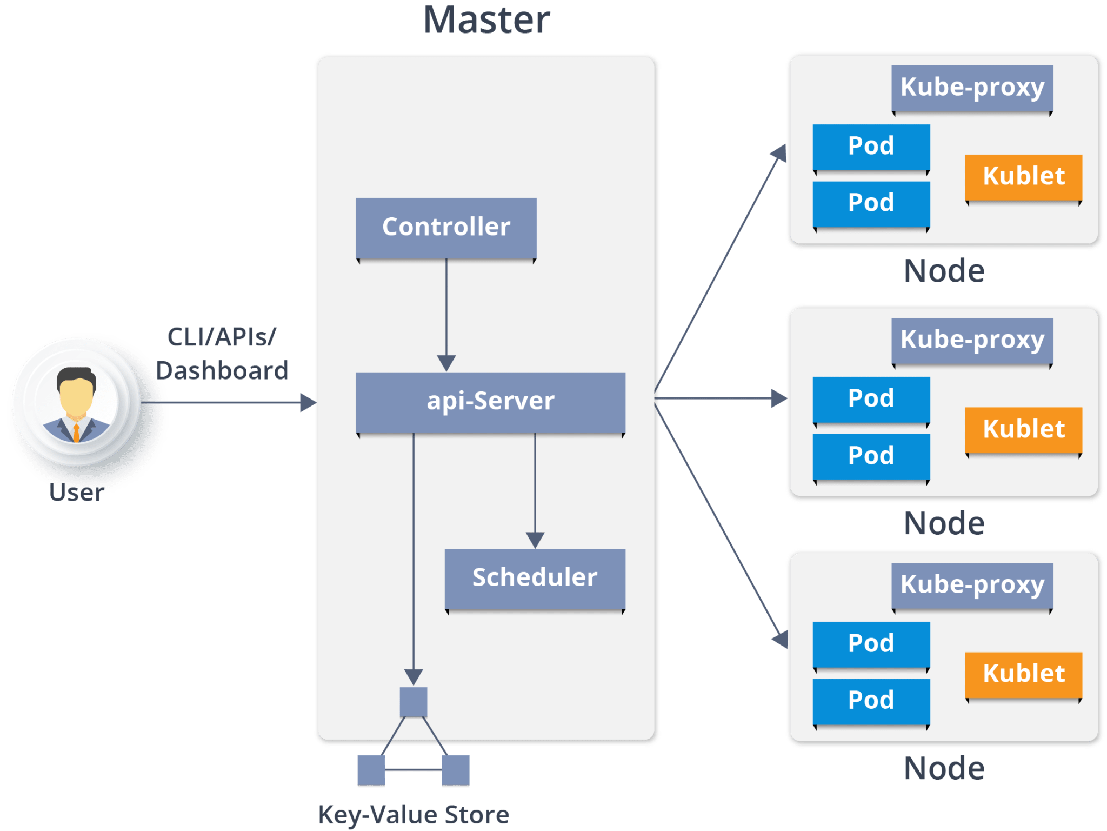
Kubernetes
Architecture

Slide 7
